Slide 1
COURT REMEDIES
Courts can do the following:
Award monetary (money) damage: damage, restitution, and punitive
Issue injunction: temporary or permanent.
Failure to obey will bring party in Contempt of Court: can impose fines, jail time, or both.
Definitions
Damage – make injured plaintiff “whole.”
Restitution – prevent defendant from profiting from wrongful action
Punitive – damages intended to reform or deter the defendant from engaging in conduct similar to that which formed the basis of the lawsuit.
Injunction: court order, which requires parties to continue, or cease, particular actions.
Contempt - offence of being disobedient to or discourteous towards a court of law and its officers in the form of behavior that opposes or defies the authority, justice and dignity of the court.

Slide 2
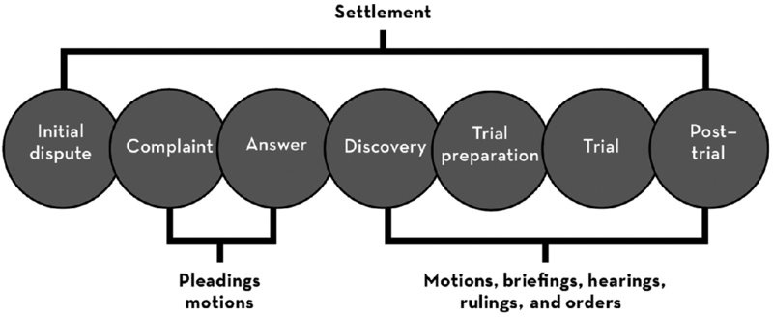
LITIGATION

Slide 3
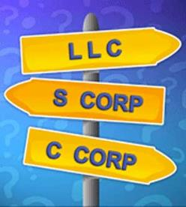
LEGAL ENTITIES

Slide 4
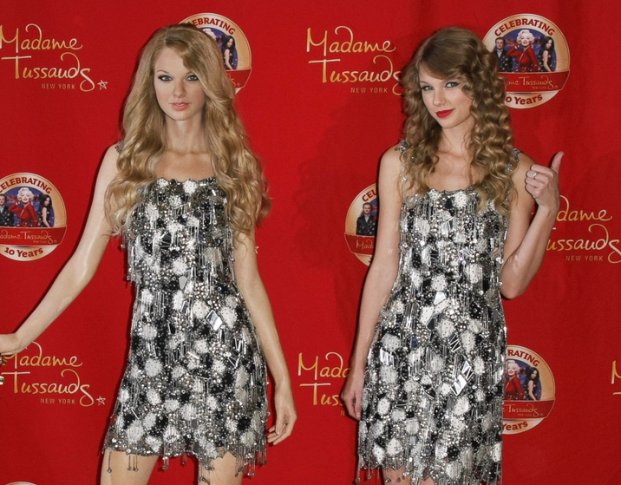
LEGAL ENTITIES
Why do legal entities exist?
Legal entities is a tool of a market economy. It allows people to take business risks without sacrificing one’s entire personal assets.
Legal entities are essentially people in the eyes of the law. They have rights but also responsibilities.

Slide 5

LEGAL ENTITIES
Types of Legal Entities
Sole Proprietorship
Partnership
Limited Liability Partnership
C Corporation
Limited Liability Company
S Corporation
Non-Profit Entities
Legal entities have legal “standing” in the eyes of law. A legal entity has legal capacity to enter into agreements or contracts, assume obligations, incur and pay debts, sue and be sued in its own right, and to be held responsible for its actions.

Slide 6
SOLE PROPRIETORSHIP
Business entity that is owned and run by one individual and in which there is no legal distinction between owner and business.
Owner receives all the profits and has unlimited responsibilities for all losses, debts, and other liabilities including taxes.
Easy to own and operate. No formalities to form sole proprietorship. Will need the necessary business licenses and permits from city, county, municipality where business exists.
May register as an “assume business name” with state where the business is located. Business name cannot be same as another business name.
No double taxation.

Slide 7
SOLE PROPRIETORSHIP
Structure | Not a legal entity One person owns the business
Liability | Unlimited including personal liability
Management | 100% control of business
Formalities | None (except business licenses)
Transferability | No restriction
Taxation | No double taxation

Slide 8
PARTNERSHIP
Two or more people co-owns a business. Can be formed without any specific intention to create partnership. This includes married couples.
Absent agreement saying otherwise, all owners have equal voice in conduct of business, have the power to bind the partnership, share equally in the profits and loses, and responsible for all operations and liabilities.
Partnerships do not need a legal document, but typically partners will sign a partnership agreement defining their rights and responsibilities.
In a general partnership, all partners are general partners.

Slide 9
PARTNERSHIP
Structure | 2 or more co-owners
Liability | Unlimited including personal liability
Management | Equal (unless agreed otherwise)
Formalities | None (but this dangerous too)
Transferability | Need permission to sell / transfer
Taxation | No double taxation

Slide 10


PARTNERSHIPS
General partners are liable for the acts of the other partner, even if those acts are unknown to the other partner(s). Is this fair?

Slide 11
LIMITED PARTNERSHIP
Similar to general partnership, except in addition to 1 or more general partners, there are limited partners.
General partners have management control, share the rights and use of partnership property, share in profits, and have joint and several liability. General partners can also bind the partnership to contracts.
Limited partners have no authority to bind the partnership. Limited partners usually help fund the partnership by granting non-management ownership interests.
General partner can be a corporation.

Slide 12
LIMITED PARTNERSHIP
Structure | At least 1 limited partner (if act as limited partner) At least 1 general partner
Liability | General partner has unlimited liability Limited partners only to investment amount
Management | General partner(s) controls
Formalities | Must file Certificate of Limited Partnership with state (Secretary of State)
Transferability | Need partner permission to sell / transfer
Taxation | No double taxation

Slide 13
CORPORATION
Like Limited Partnerships, corporations management structure is separate from the investors.
Shareholders, like limited partnerships, are not liable for debt incurred and have no management authority by reason of their share ownership.
Shareholders meet annual to elect board of directors. Directors selects the corporate officers who manage the day-to-day operations.
Management is defined by corporate charter, bylaws, and board resolutions. Charter is a basic organization document filed with state where corporation is organized. Bylaws are more detailed set of corporate structure including rights, powers, and duties to the shareholders. Board resolutions are passed by the Board and specify direction of corporation.

Slide 14
CORPORATION
Structure | A legal entity (like a person)
Liability | Corporation is liable (shareholders, directors, and officers are not liable even if they make the bad decisions unless “pierce the corporate veil”)
Management | Board of Directors (who often select officers)
Formalities | Must file Article of Incorporation with state Usually filed in Delaware
Transferability | Can sell shares without restrictions
Taxation | Double Taxation

Slide 15
C CORPORATION
C Corporations are often considered the most attractive entity to investors including angle investors and venture capitalists. No limitation to the number of shareholders.
C Corporation can issue preferred stocks that can be converted to common stock at advantageous rates.
Preferred stocks have a greater level of protection by providing priority over common shareholders in liquidation.
C Corporation can issue employee stock options.

Slide 16
LIMITED LIABILITY COMPANY (LLC)
LLC is a flexible enterprise that blends elements of partnership and corporation. LLC are formed by filing the articles of organization, which is analogous to corporate charter.
Owners of a LLC are called “”Members.” Can have nearly any number of members including 1.
LLC do not have stocks and are not required to observe corporate formalities.
Members are not personally liable for the debts and actions of the LLC.

Slide 17
LIMITED LIABILITY COMPANY (LLC)
LLC can be member-managed, manager-managed, or director-managed. Member-managed is most appropriate for startups, where there are few people but all are active. Manager-managed, members elect managers who have power similar to general partners. A director-managed has a board of directors and officers like a corporation.
An LLC’s operating agreement is an agreement between the members. It is analogous to a corporation’s bylaws.
LLC owns must pay taxes on their distributed shares of the profits even if they have not received a distribution share of those profits. In comparison, share owners of a corporation do not pay unless they are actually paid, usually in the form of dividends.

Slide 18
LIMITED LIABILITY COMPANY
Structure | Hybrid of corporation and partnership
Liability | Liability protection for members
Management | All members can control
Formalities | Must file Article of Organization with State May not be available for professional services
Transferability | Need permission of all members to transfer
Taxation | No double taxation

Slide 19
S CORPORATION
S Corporation avoids double taxation while enjoying limited liability. S corp, despite the name, is a LLC with a tax election.
Formed under the subchapter S of the Internal Revenue Code.
S Corporation passes income, losses, deductions, and credits through its shareholders for inclusion on their individual tax returns (such as partnerships)
To be eligible:
  Domestic corporation with only one class of stocks with identical rights
  No more than 100 shareholders, all of whom must be individuals
  Individuals who are citizens of the U.S.

Slide 20
NOT FOR PROFIT
Formed for reasons other than profit-seeking business.
Referred to by the IRS as 501(c) corporation, named after the section in the IRS code designed for non-profit corporations.
Many non-profit wants to obtain 501(c) status as they can avoid paying federal income taxes and some state taxes.
Section 501(c) lists the 28 categories for overall purpose.

Slide 21
RISKS AND LIABILITY
Sole proprietorship is easiest to form, but has the highest degree of liability including personal liability.
General partners have unlimited personal liability including joint and several liability. This means each partner can be fully responsible personally for debts. If one partner enters into a contract on behalf of the partnership, contact is only enforceable against the partnership and all general partners even if the other partner was not aware of the agreement.
Limited Liability Partnerships allows for general partners to avoid personal liability for involuntary partnership obligations. Typically, partners are only liable for their own acts.

Slide 22
RISKS AND LIABILITY
Corporations shields its shareholders, directors, and officers from personal liability for the obligations of the corporation.
Officers of a corporation must sign documents and checks in their role as officer of a corporation, otherwise the they may be personal liable under a theory of “piercing the corporate veil.”

Slide 23
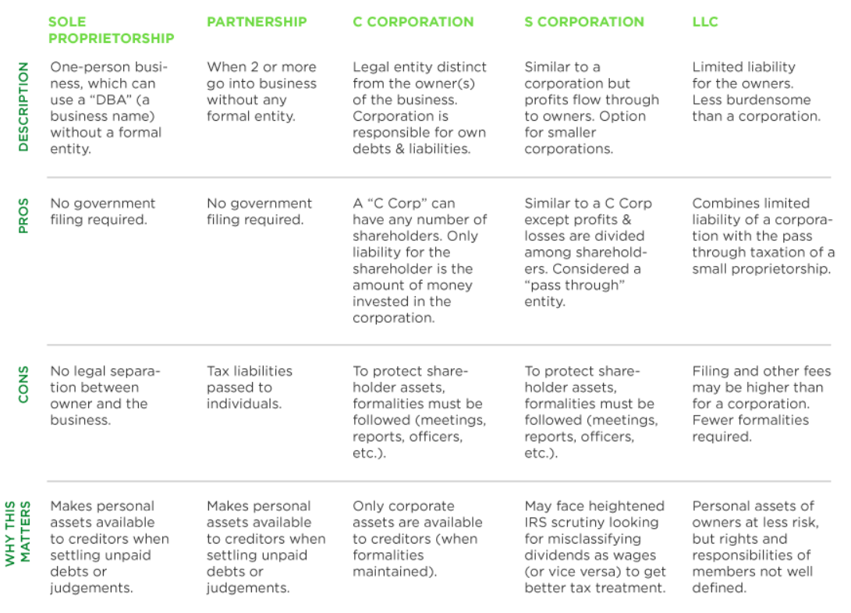
CHART

Slide 24
PIERCING CORPORATE VEIL
Legal Entities will only protect if the party treats it as a separate entity.
A situation in which courts put aside limited liability and hold a corporation's shareholders or directors personally liable for the corporation's actions or debts. Veil piercing is most common in close corporations.
Most common situation where the legal entity will not protect owners if there is no truly separation, such as “co-mingling assets.” Example is to use legal entity’s bank account to pay for personal bills.
Other is failing formalities such as holding annual meetings, keeping records, and adopting bylaws

Slide 25
FLORIDA PIERCING CORPORATE VEIL
In Florida, “piercing the corporate veil” is governed by Florida Supreme Court case Dania Jai-Alai Palace, Inc. v. Sykes, 450 So. 2d 1114 (Fla. 1984), which holds “the corporate veil may not be pierced absent a showing of improper conduct.”
Therefore, the corporate veil will not be penetrated either at law or in equity unless it is shown that the corporation was organized or employed to mislead creditors or to work a fraud upon them. Dania Jai-Alai, 450 So. 2d at 1120.
the shareholder dominated and controlled the corporation to such an extent that the corporation’s independent existence, was in fact non-existent and the shareholders were in fact alter egos of the corporation;
the corporate form must have been used fraudulently or for an improper purpose; and
the fraudulent or improper use of the corporate form caused injury to the claimant.

Slide 26
CASES
Dania Case
USP Real Estate v. Discount Auto
Facts: a woman was hit by a car in the parking lot of a store owned by Dania Jai-Alai, Inc. The car was driven by a valet who was employed by Carrousel, Inc., a sister corporation of Dania Jai-Alai. Both companies were owned by Saturday Corporation. Woman tried to “pierce the corporate veil” to get at the assets of Saturday corporation and argued they were setup merely to avoid liability (i.e. shell companies).
Held: Woman failed because there is no evidence of “improper conduct.”
Facts: #90 North is a subsidiary of Discount Auto. #90 leased a property from USP to sell auto parts. Before the lease expired, #90 abandoned the property. USP sued Discount Auto for breach of contract. Evidence shows #90 never held a bank account, did not filed tax returns, had no agreement with Discount Auto. #90 was created simply to shield Discount Auto from liability
Held: Court pierce the corporate veil because #90 was simply created to hold the lease to shield Discount Auto from liability if the lease was broken.

Slide 27
FIDUCIARY DUTY
Directors of corporations, in fulfilling their managerial responsibilities, are charged with certain fiduciary duties. The primary duties are the duty of care and the duty of loyalty.
Duty of Care - this duty requires that directors inform themselves “prior to making a business decision, of all material information reasonably available to them.”
Duty of Loyalty - corporate officers and directors are not permitted to use their position of trust and confidence to further their private interests
Duty of Good faith - Requiring the director to advance interests of the corporation. For a thorough discussion of this duty.
Duty of Confidentiality: Required directors to keep corporate information confidential.
Duty of Disclosure: This duty requires directors to act with “complete candor.” In certain circumstances, this requires the directors to disclose to the stockholders “all of the facts and circumstances” relevant to the directors’ decision.

Slide 28
BUSINESS JUDGMENT RULE
A legal principle that makes officers, directors, managers, and other agents of a corporation immune from liability to the corporation for loss incurred in corporate transactions that are within their authority and power to make when sufficient evidence demonstrates that the transactions were made in Good Faith.
Shlensky v. Wrigley – Shlensky, a minority shareholder, challenged Philip Wringley’s decision to install lights in the Wrigley Field so Chicago Cubs could play during the evenings and get more attendance and higher revenue for the company.
Question – if Shlensky can absolutely prove he is right, has Wringley violated his fiduciary duty?

Slide 29
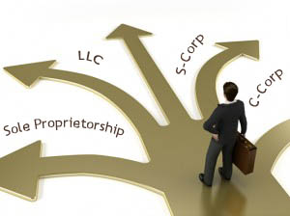
WHICH ENTITY IS THE BEST?
The “best” entity is one that best balances your interest in the following:
Tolerance for “formalities” or paperwork?
Who will own the company?
How will money be made?
Who will run the company?
What are the gross revenue?
What are the project net profits?

Slide 30
VARIABLES TO CONSIDER
Purpose
Formalities (paperwork)
Owners
Co-Owners
Management
Gains/Loss Allocation
Cash Out
Taxes

Slide 31

TAX: SOLE PROPRIETOR
Tax applies to “net profit,” which is gross profit minus expenses and deductions.
NET PROFIT is subject to the following taxes:
Self-Employment Tax (15.3%)
State and Federal Income Tax (20%)
Assume Net Profit of $100,000
Self-employment Tax = $15,300
Federal and State Income Tax on Remaining $85,000 = $17,500
Total = $33,000 ($2,750 / month)

Slide 32
TAX: S-CORP
Net Income = 100,000
Payment of Salary (Self-Employment Tax)
Payment of Distribution (No Self Employment Tax)
Payment of Salary must be “Reasonable.” Cannot pay yourself nothing. Typically based on market analysis.
Net Income = 100,000
Payment of Salary = $60,000 ($9,180 in self-employ tax)
Distribution = $40,000 ($8,000 in federal and state tax)
Self-Employment Tax Savings: $15,300 - $9,180 = $6,120

Slide 33
OWNERS
Non-U.S. Citizens
U.S. Citizens
Sole Proprietorship
General Partnership
Limited Partnership
C Corporation
Limited Liability Company
S Corporation

Slide 34
CO-OWNER PROTECTION
Personal Liability Protection
Personal Liability Exposure
Limited Liability Partnership
S Corporation
C Corporation
Limited Liability Company
General Partnership
General Partners in a Limited Liability Partnership

Slide 35
MANAGEMENT
Company / Person
Person
Limited Liability Partnership
Limited Liability Company
C Corporation
Sole Proprietorship
S Corporation

Slide 36
TRADING OWNERSHIP
Restricted
Non-Restricted
Sole Proprietorship
General Partnerships
Limited Partnerships
S Corporation (limited to 100 shareholders)
C Corporation

Slide 37

FORMING A CORPORATION OR LLC
Forming LLC (S-Corp)
http://dos.myflorida.com/sunbiz/start-business/efile/fl-llc/
Forming C Corporation
http://dos.myflorida.com/sunbiz/start-business/efile/fl-profit-corporation/

